Slide 1
Batch Prediction Versus Online Prediction
Pravin Y Pawar
Adapted from ‘Designing Machine Learning Systems”

Slide 2
Three main modes of prediction
Batch prediction, which uses only batch features
Online prediction that uses only batch features (e.g., precomputed embeddings)
Aka on-demand prediction
Online prediction that uses both batch features and streaming features
aka streaming prediction

Slide 3
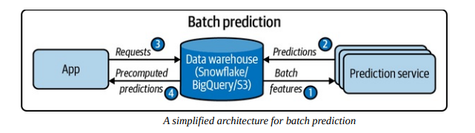
Batch prediction
When predictions are generated periodically or whenever triggered
Predictions are stored somewhere, such as in SQL tables or an in-memory database, and retrieved as needed
For example,
Netflix might generate movie recommendations for all of its users every four hours,
the precomputed recommendations are fetched and shown to users when they log on to Netflix
AKA asynchronous prediction: predictions are generated asynchronously with requests

Slide 4
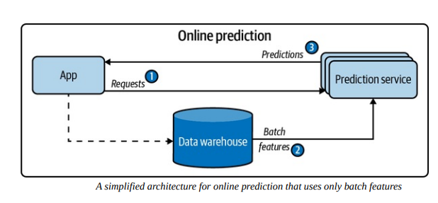
Online prediction
Using only batch features
When predictions are generated and returned as soon as requests for these predictions arrive
For example, enter an English sentence into Google Translate and get back its French translation immediately
aka on-demand prediction
Traditionally, when doing online prediction, requests are sent to the prediction service via RESTful APIs
aka synchronous prediction: predictions are generated in synchronization with requests

Slide 5
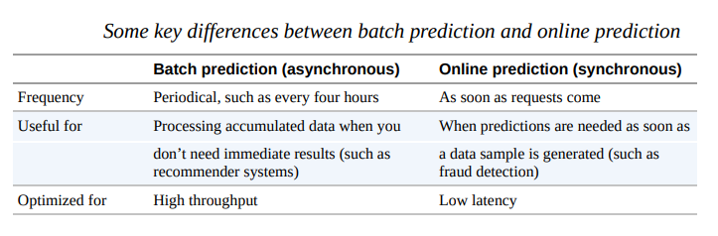
Online vs Batch prediction

Slide 6
Online prediction
Using both batch and streaming features - “streaming prediction”
Batch features
features computed from historical data, such as data in databases and data warehouses
for e.g. a restaurants rating
Streaming features
Features computed from streaming data — data in real-time transports
for e.g. estimation for delivery time
In batch prediction, only batch features are used
In online prediction, however, it’s possible to use both batch features and streaming features.
For example, after a user puts in an order on DoorDash, they might need the following features to estimate the delivery time:
The mean preparation time of this restaurant in the past
In the last 10 minutes, how many other orders they have, and how many delivery people are available

Slide 7
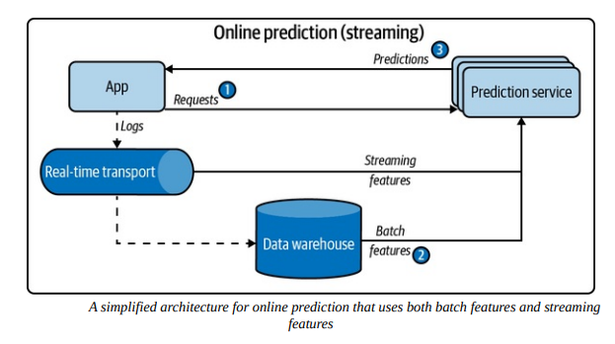
Streaming prediction
A simplified architecture for online prediction that uses both streaming features and batch features

Slide 8
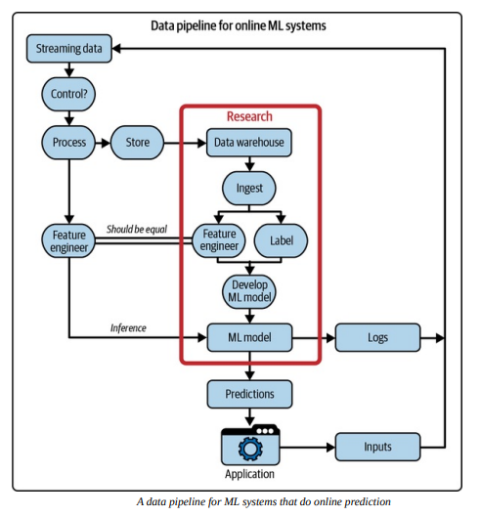
Unifying Batch Pipeline and Streaming Pipeline

Slide 9
Thank You!
In our next session:

